Slide 1

Book Odyssey - The Book Trial
A MySQL-Based C2C Marketplace for Academic Books
Database Management System Project | B.Tech 2nd Year

Slide 2

The Academic Book Crisis
₹15,000-₹25,000
68%
Annual textbook spending per student
Students struggle with book affordability
No Dedicated Solution
Generic marketplaces lack academic focus and charge high fees
Our Solution: A specialised C2C platform exclusively for academic books with zero listing fees, prioritising educational content and sustainable book circulation.

Slide 3
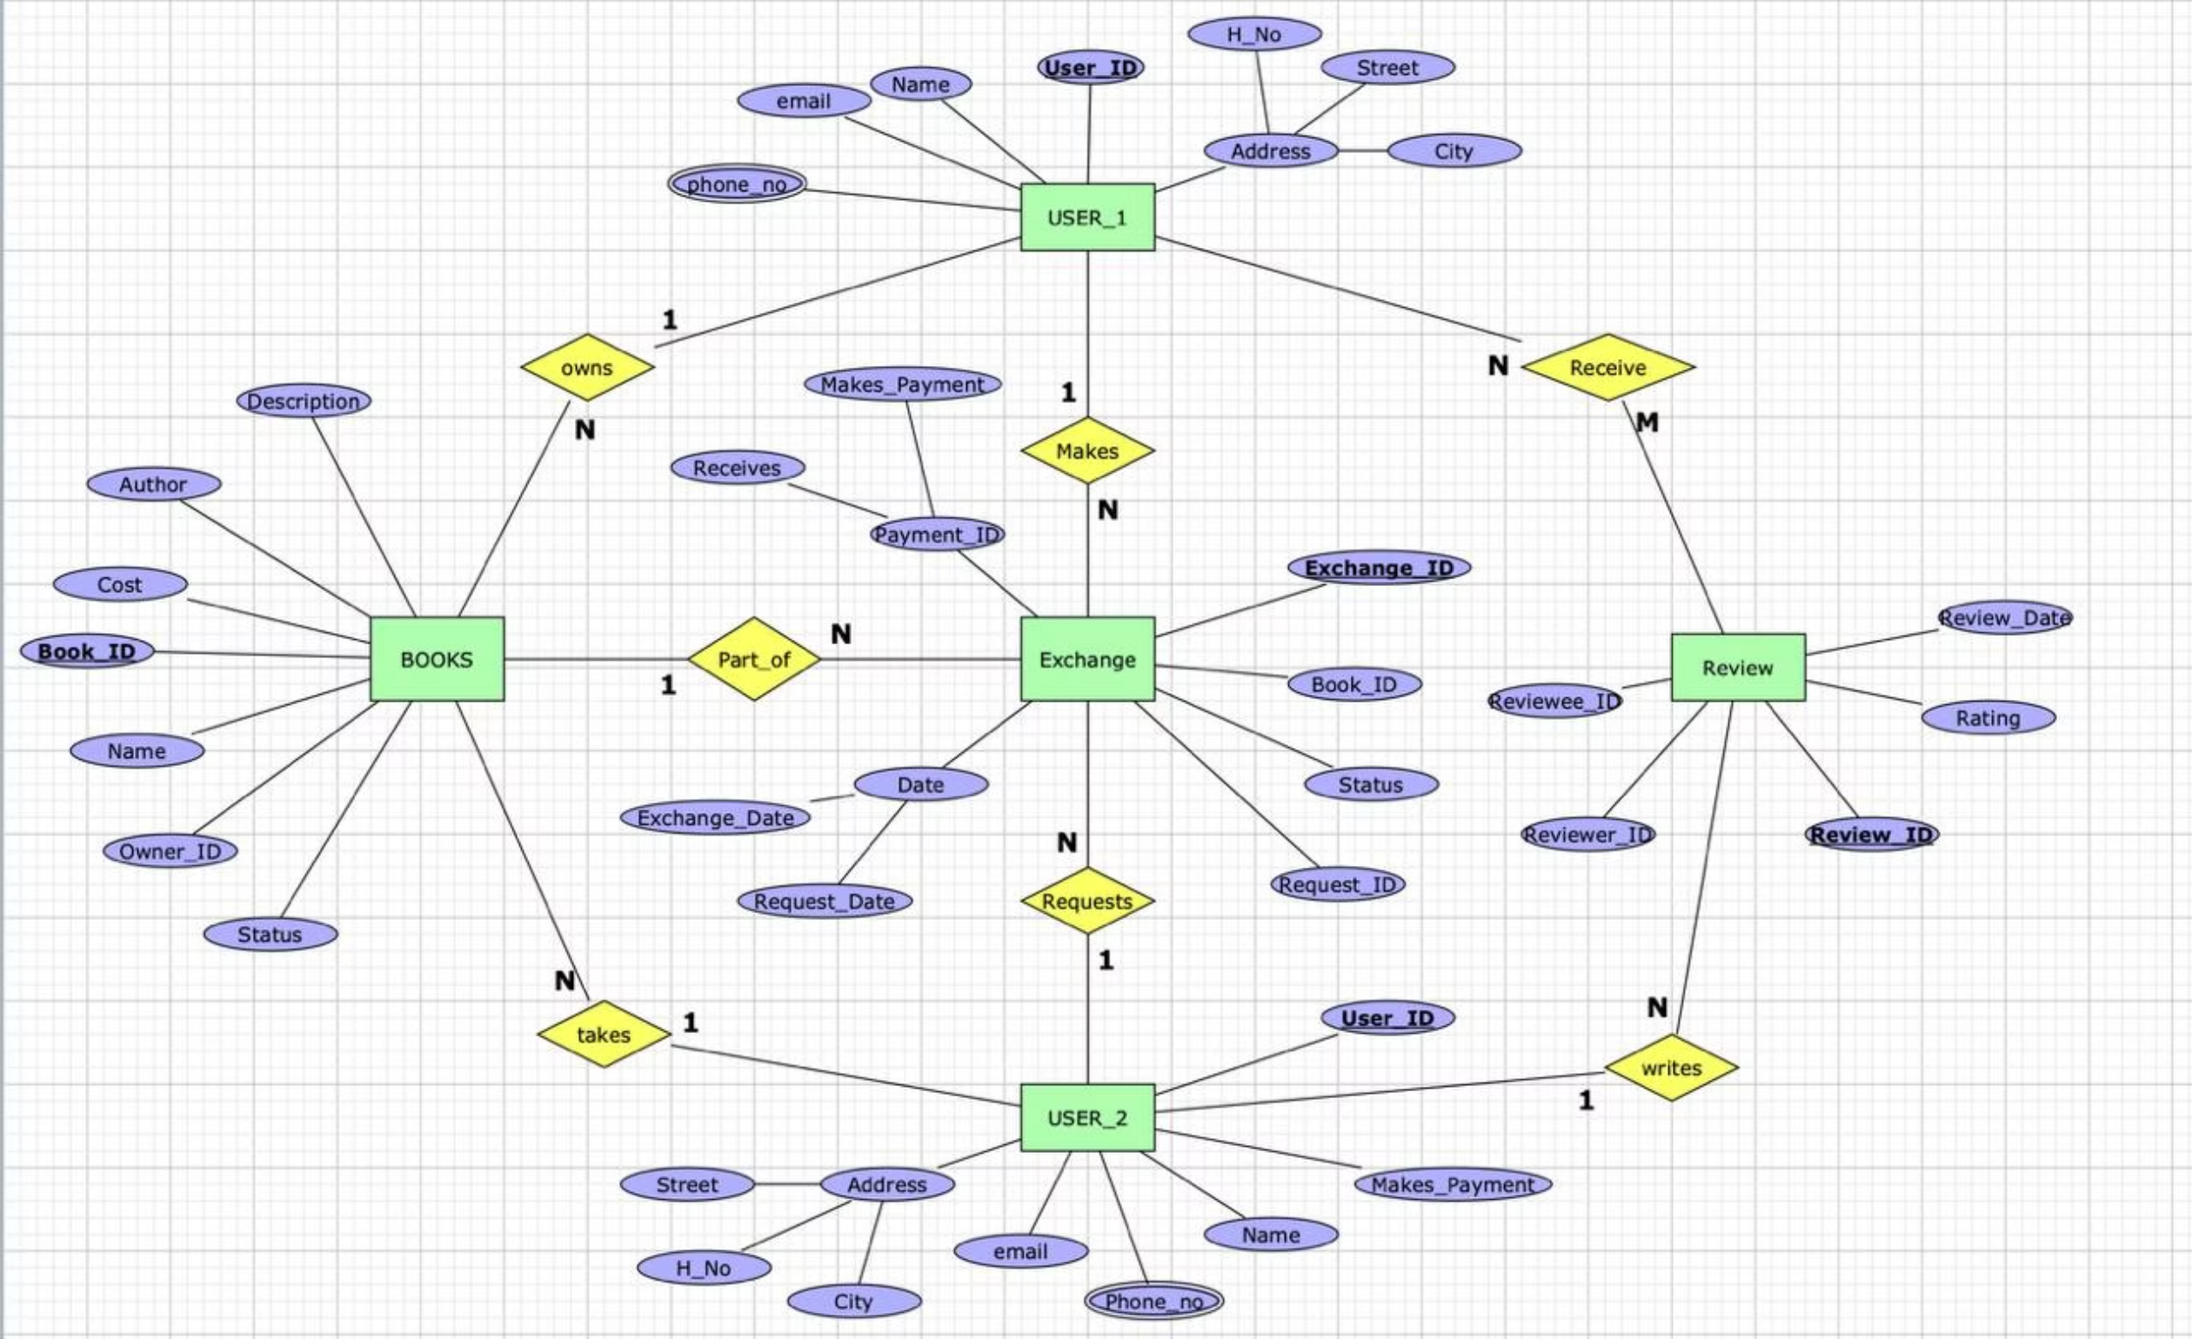
ER diagram

Slide 4
Technical Architecture & Database Design
Technology Stack
Database Schema Highlights
Frontend: React.js with Component-Based Architecture
8 Interconnected Tables with referential integrity
Backend: Node.js + Express.js (RESTful API)
Normalised to 3NF (Third Normal Form)
Database: MySQL with Normalised Schema
Foreign keys, unique constraints, ENUM validations
Real-time: WebSocket (Socket.io) for chat
CASCADE operations for data consistency
Storage: Cloudinary/AWS S3 for images
Indexed columns: user_id, listing_id, category_id

Slide 5






Innovative & Sustainable Features
Intelligent Prioritisation
Flexible Models
Educational books ranked higher, category filtering, location-aware search
Sell, Exchange, or Hybrid—matching student preferences perfectly
Condition Verification
Sustainability
Ratings from New to Used with photo verification
Extends book lifecycle 3-5 years, reduces carbon footprint significantly
Wishlist System
Real-time Chat
Availability notifications keep users informed instantly
Instant WebSocket communication between buyers and sellers

Slide 6



System Workflow & User Experience
Create Listing
Registration & Profile
Multi-step form: Details, Images, Pricing, Location
Set up account and complete profile information
Complete Transaction
Activate & Communicate
Negotiate, exchange, or purchase—then mark as sold
Listing goes live, receive buyer requests via real-time chat
API Structure: Authentication via JWT (20+ RESTful endpoints), Listings CRUD with search/filter, WebSocket chat initiation, and Wishlist management with user-listing uniqueness constraints.

Slide 7

Societal Impact & Results
Direct Student Benefits
Environmental Impact
60-70% Cost Savings: ₹10,000+ per year
Each reused book saves 7.5 kg CO₂
Access to rare and out-of-print editions
Circulate 10,000+ books annually
Community connection with peers in same courses
Extend book lifespan from 1-2 to 5-7 years
Zero platform fees create a sustainable marketplace that reduces financial barriers to education whilst promoting circular economy principles.

Slide 8
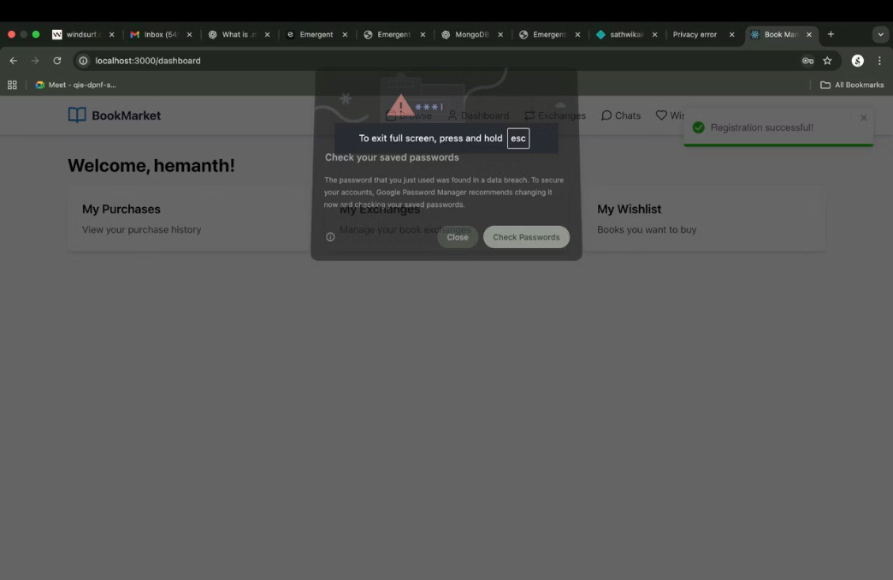
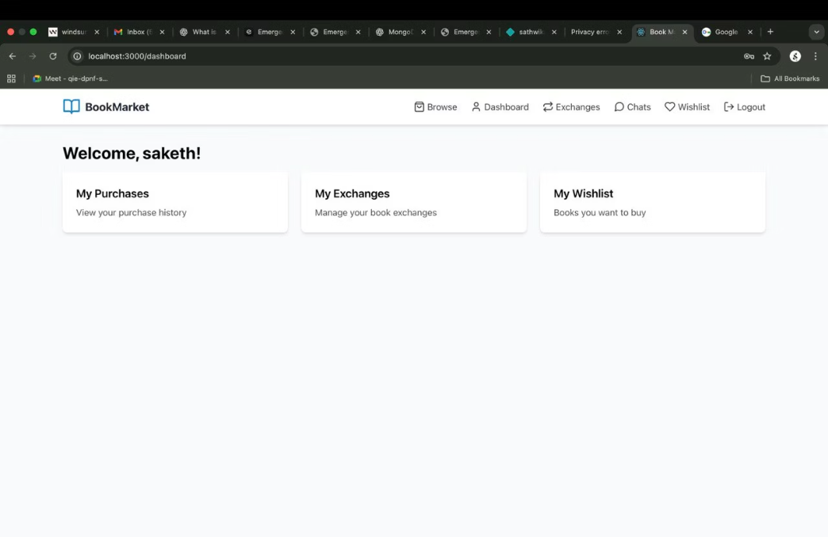
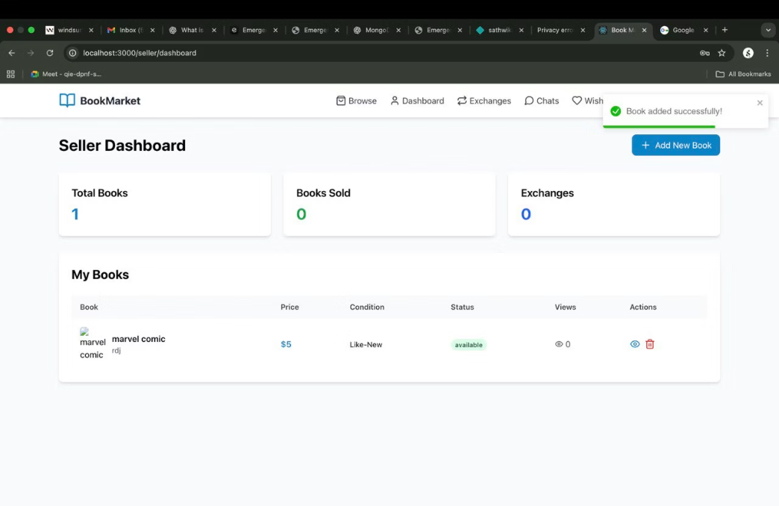
Results :
Login (seller)
Buyer - dashboard
Seller Dashboard
an example of successful login attempt from seller
an example of successful login attempt from Buyer

Slide 9
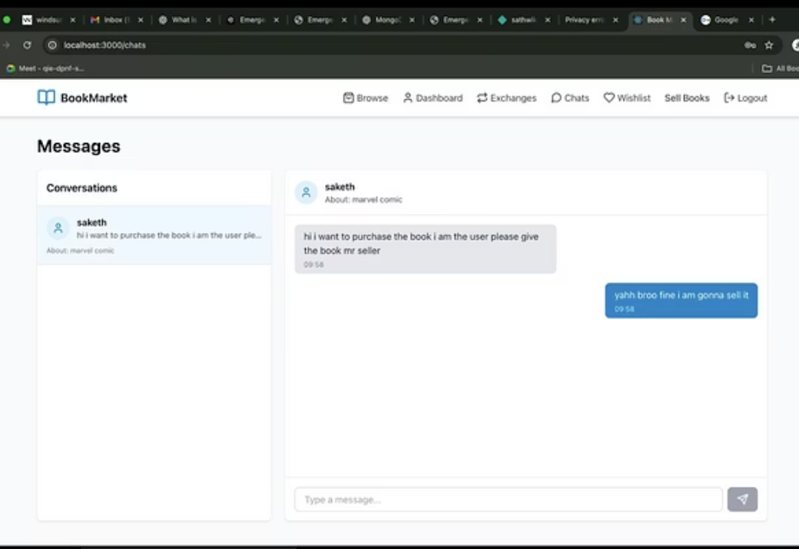
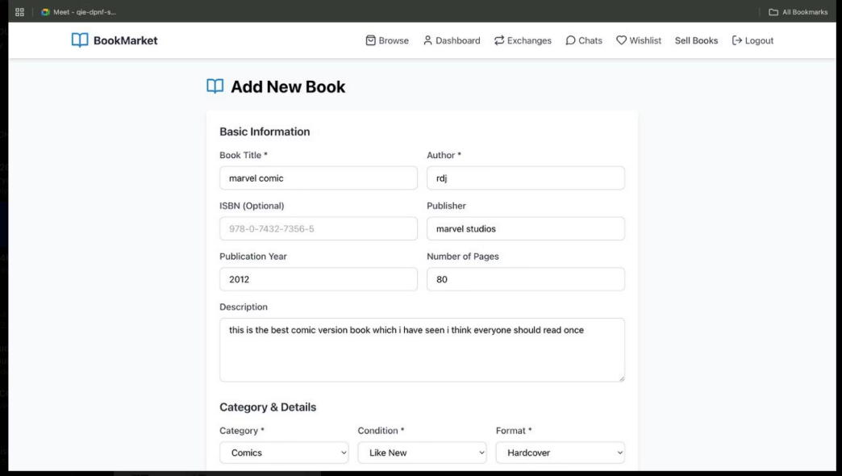
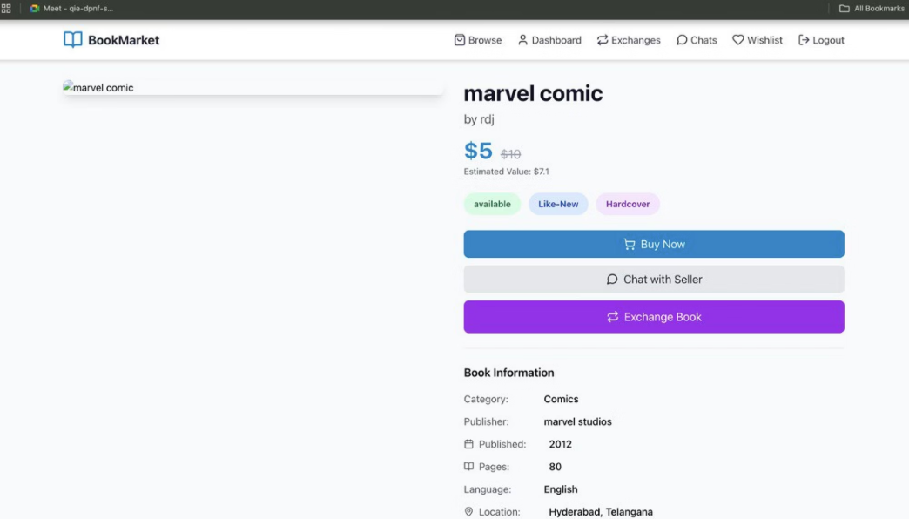
Selling a Book
Details about a Book
Chat option

Slide 10

Implementation Status & Technical Validation
Database Schema Complete
Backend Architecture Defined
Normalised 8-table design with referential integrity and ER diagram validated
20+ RESTful endpoints planned with JWT authentication and security protocols
Security Implemented
Testing Strategy
Bcrypt password hashing, input validation, SQL injection prevention, protected routes
Unit, integration, and database transaction testing for data integrity assurance
Performance Optimisations: Indexed columns for rapid queries, prepared statements, and location-based search optimisation ensure scalable, efficient operations.

Slide 11

Project Achievements
Database-Driven Solution
Technical Competence
Full-stack development with normalised schema and secure APIs
Comprehensive system addressing real student needs
Measurable Impact
Sustainable platform with proven societal and environmental benefits

Slide 12
Future Roadmap & Innovation
AI-Powered Recommendations
Intelligent matching based on course enrollment and reading preferences
Mobile Application
React Native app with push notifications for real-time updates
University Partnerships
Official integration with course syllabi and institutional support
Review & Rating System
Build trust through verified transaction feedback mechanisms
Advanced Analytics
Admin dashboards tracking trends and platform insights

Slide 13

Book Odyssey
Transforming how students access education by making knowledge affordable, sustainable, and community-driven. Our database-backed platform ensures secure transactions whilst reducing the environmental footprint of academic publishing.
Making education accessible, one book at a time.

